Slide 1
Executive Summary Report for Predicting DTC App User Engagement Analysis
By Mariam Ariya
16th August 2022

Slide 2
Business Understanding
Assessing customers response to a product, service, website or a new feature on the company's app is equally as important as acquiring and retaining them. Customer/User engagement helps understand
how your customers interact with your website, content or app
measure marketing campaign effectiveness.
Understanding this is therefore important as it allows the company provide more engaging content, refine their strategy, upgrade customer service and better the user experience.

Slide 3
Goal
Determine the relationship between marketing spend and user engagement on the app.
Build a model to predict future outcomes of the DTC app user clicks.
This will help prevent problems or inform decision like marketing campaign budget, Improving customer satisfaction, and Increasing customer retention.

Slide 4
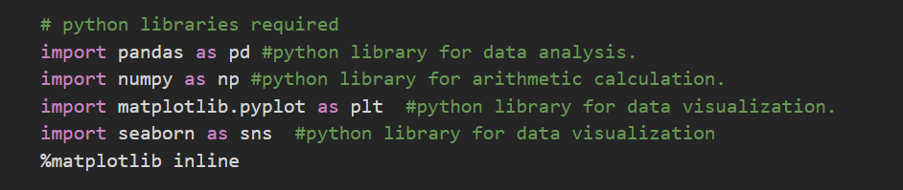
Data Understanding
The dataset was opened in Microsoft Excel, saved in a csv format and imported into Jupyter Notebook which is the IDE used for this project.
Started by importing all necessary modules for the analysis.
A dataframe called df was created and data loaded into it using the pd.read_csv() method since the data was saved in a csv format.
After loading, the data was validated by using the .head() and .tail() methods to get the first 5 and last 5 rows, respectively.

Slide 5
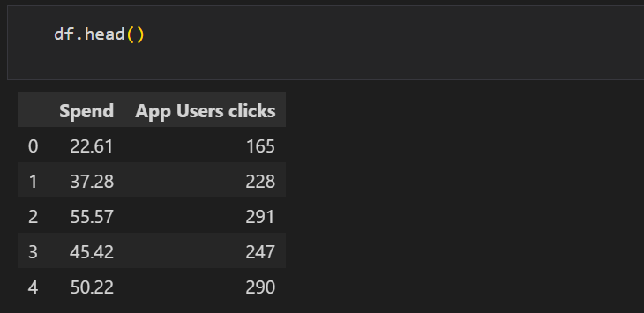
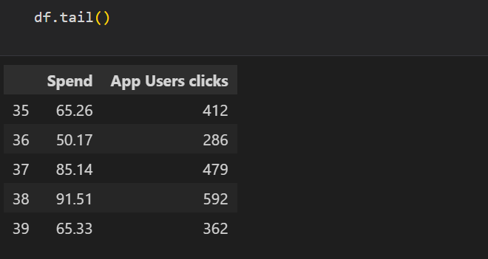

Slide 6
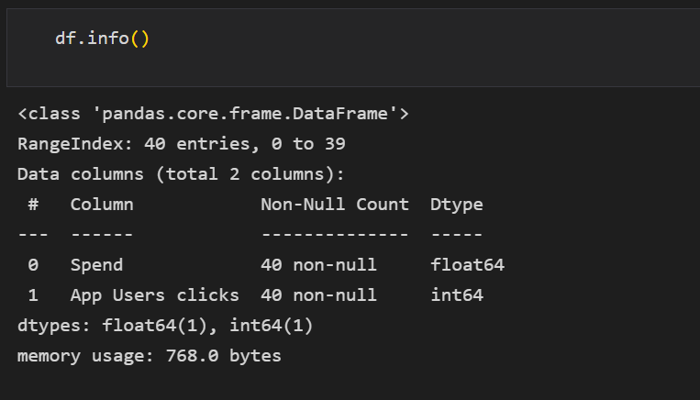
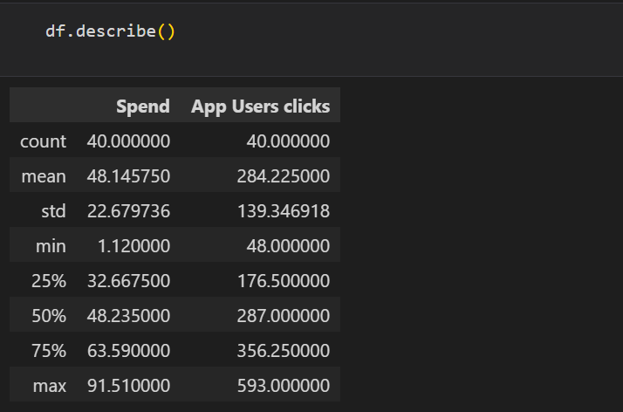
.info() was also used to get information about the dataframe. The result contained the number of columns, column labels, datatypes, memory usage, range index and the number of non-null values in each cell.
.describe() function was used to generate the statistical summary of the dataframe which includes the count, mean, median, min, max and percentile values of numeric columns.

Slide 7
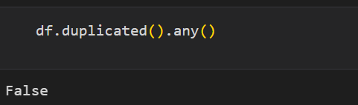
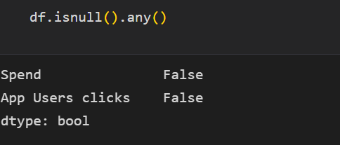
Data Cleaning
This process involved checking for datatypes, missing and duplicates values, standardizing column names, performing correlational and outlier analysis to check the relationship between variables and extreme values, respectively and feature engineering.
Checked for duplicated values by using the pandas method .duplicated().any() .
This pandas method returned Boolean value False which means there are no duplicate values in the dataset.
And missing values using .isnulla().any() method to check for missing values.
This pandas method returned Boolean value False which means there are no missing values in the dataset.

Slide 8
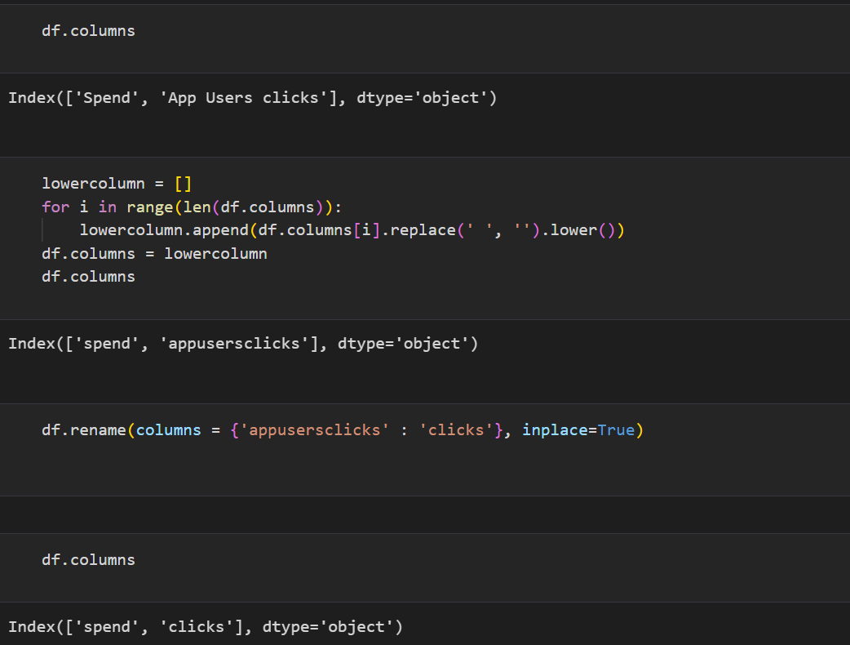
Column names were checked using .columns in pandas, transformed to lower cases using .lower() and renamed using .rename() method.

Slide 9
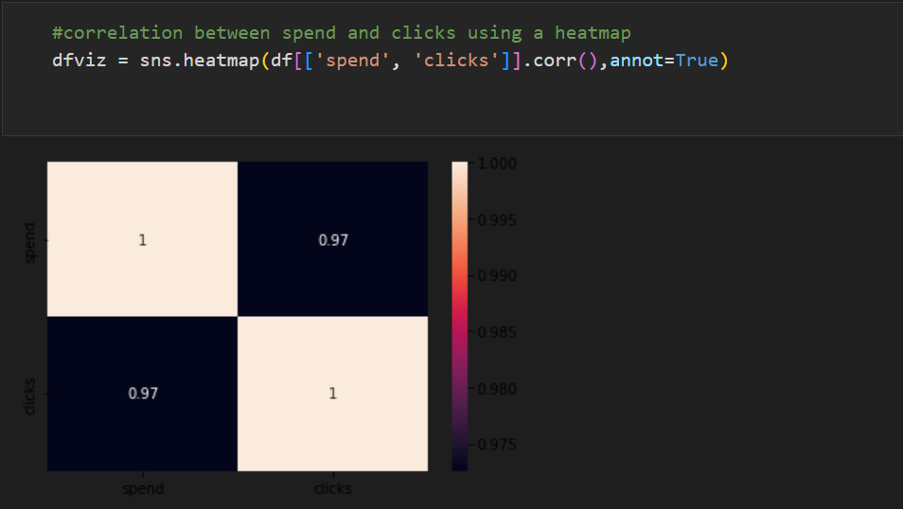
Performed correlational analysis to determine the relationship between marketing spend and clicks using heatmap.
There is a strong positive relationship between both variables.

Slide 10
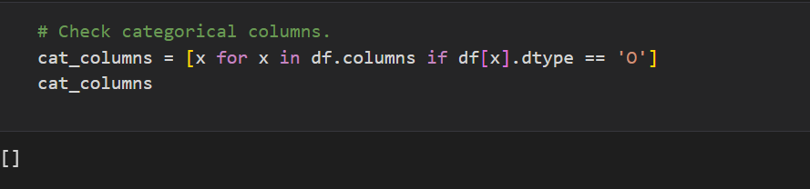
Featured Engineering
This process involves creating new metrics for columns needed for the analysis, removing variables not needed and changing categorical variables to numeric to prepare for model building.
In this case, no columns were dropped or added because we already have the necessary columns for the model and no columns were converted to numeric as it found none.

Slide 11
Insights
There are a total of 40 observations with 2 variables(columns).
There are no missing values, and all variables have their correct data types.
No duplicates were also recorded.
There are no outliers.
There is a strong positive correlation between marketing spend and the number of clicks on the app.

Slide 12
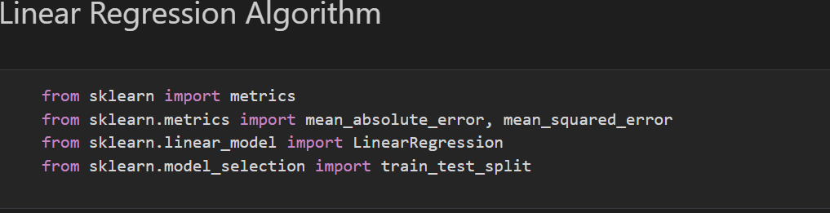
Modelling
This prediction model is a regression model since the result will be numeric and the model will be built with Linear Regression Algorithm.
We also must define the input(independent variables) and output(dependent variables) features. The dependent variable will be the column to be predicted while the independent will be all other columns after the forecasted column has been dropped.
The dependent variable will be dropped using the .drop() method in python.
The necessary python libraries needed for machine learning are also imported below:

Slide 13
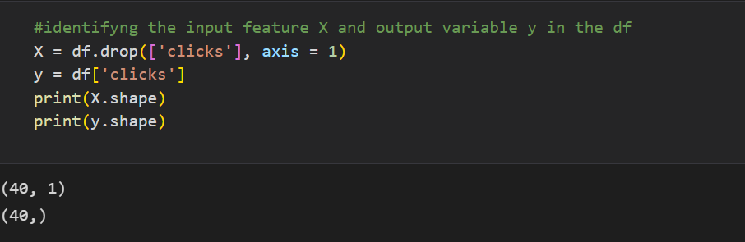
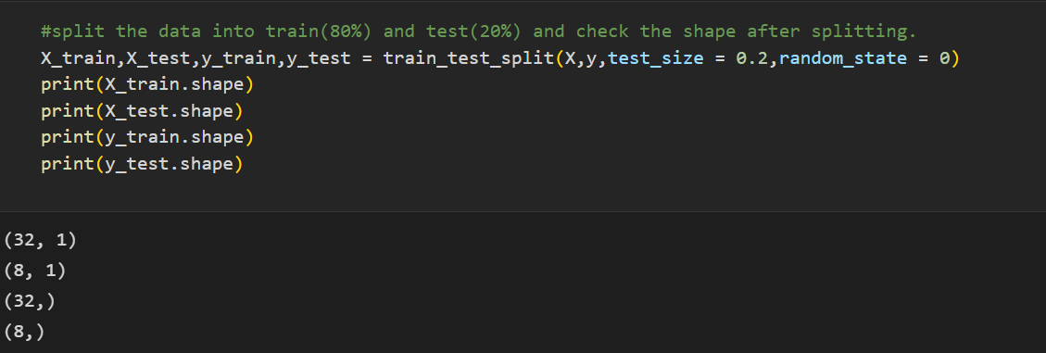
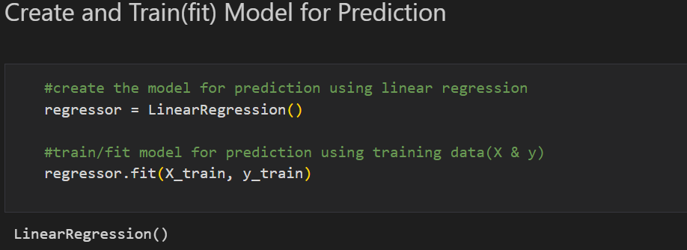
The data must be split into Training and Testing sets which is usually divided using the 80:20 ratio rule i.e., model will be trained with 80% of the data and tested with 20% of the data.
The Regression model to be used is created and trained using .fit() method below.

Slide 14
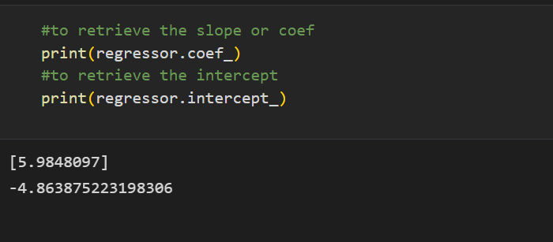
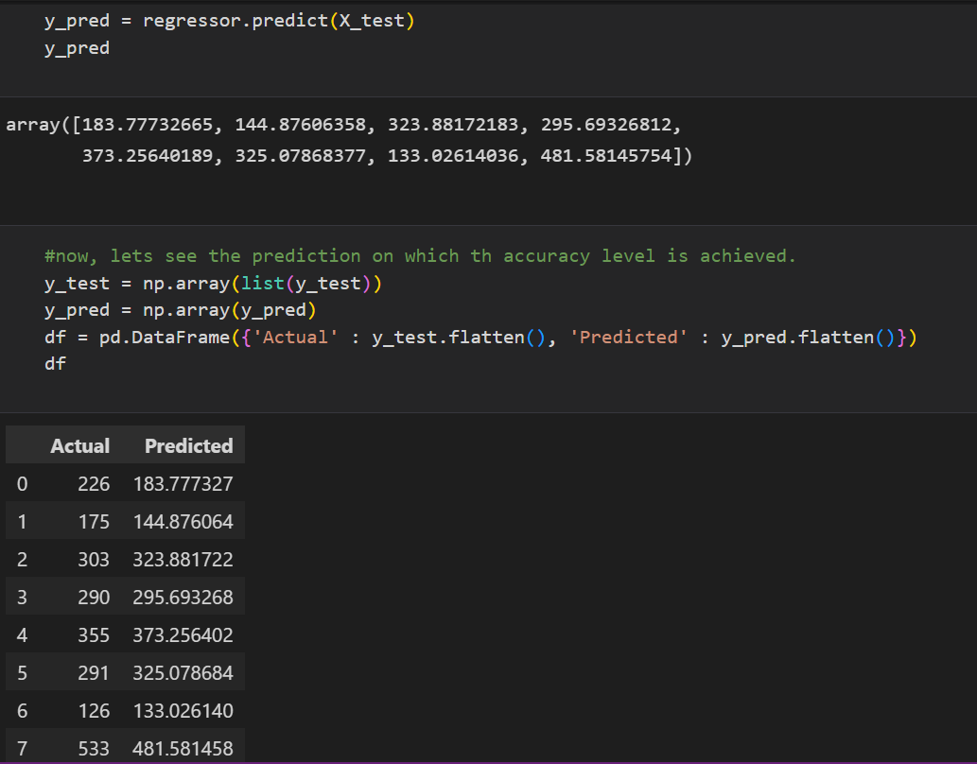
The Coefficient/Slope and Intercept of the model was determined using .coef_ and .intercept_ respectively.
Coefficient is 5.98 which means that for every dollar spent on marketing, there is ~6 clicks on the app.
The model is tested on the testing data and put in a dataframe to compare the actual and predicted values.

Slide 15
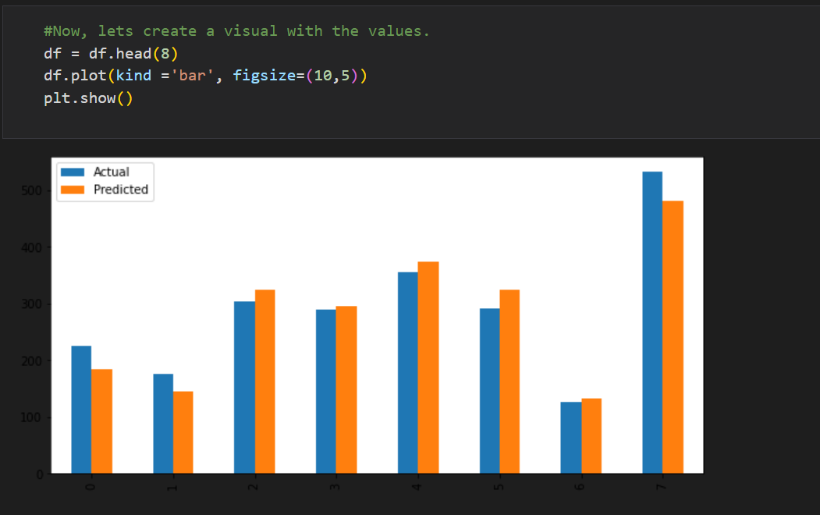
Graphical representation of the actual and predicted values.

Slide 16
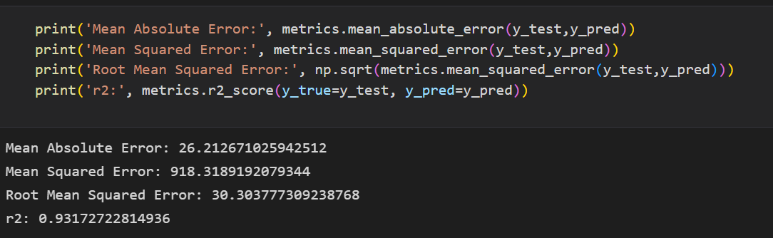
Insights
The model has:
Mean Absolute Error of 26.2126
Mean Squared Error of 918.3189
Root Mean Squared Error of 30.3037
R-squared of 0.9317 i.e. 93%

